Slide 1


Slide 2
GROUP MEMBERS
- SAJJAD ALI SYED (N01485698)
- SONAL POOJA (N01474010)
- ROHAN PATEL (N01469929)
- JUNZHI CHEN (N01563594)

Slide 3
PURPOSE OF THIS ANALYSIS
- We have used Diabetes dataset from Kaggle as our problem statement.
- The dataset has 9 columns and 768 rows (500 non-diabetics and 268 diabetics). The binary classification outcome variable takes (0 or 1) values, where 0 indicates a negative test for diabetes, and 1 implies a positive test.
- Diabetes is a chronic (long-lasting) health condition that affects how your body turns food into energy.
- With diabetes, our body doesn’t make enough insulin or can’t use it as well as it should.
- The objective is to predict the parameters that can increase the chances of a person getting diabetes based on diagnostic measurements.

Slide 4
BIG DATA TOOLS
- HDFS which is the default framework.
- Hive which is used to create external tables.
- Hbase, Hbase helps us to see more from our data by adding more dynamics, linking with Hive.
- Zeppelin, analyzed tables can be displayed in Zeppelin Notebook with various visualizations.

Slide 5
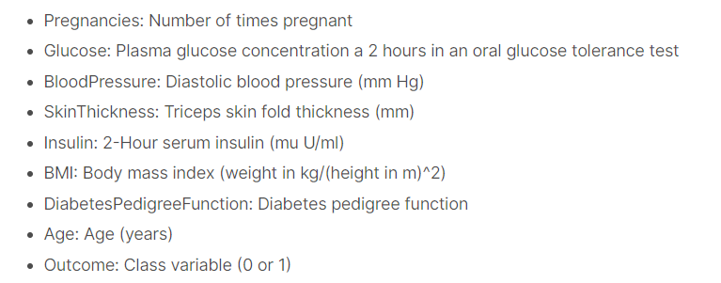
PARAMETERS

Slide 6
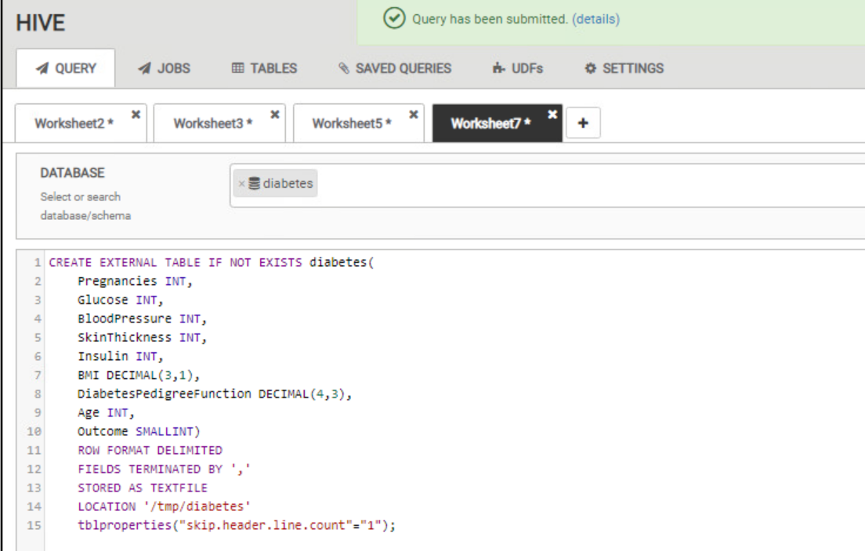
HIVE

Slide 7
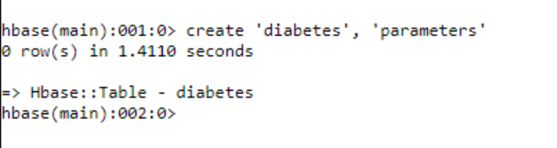
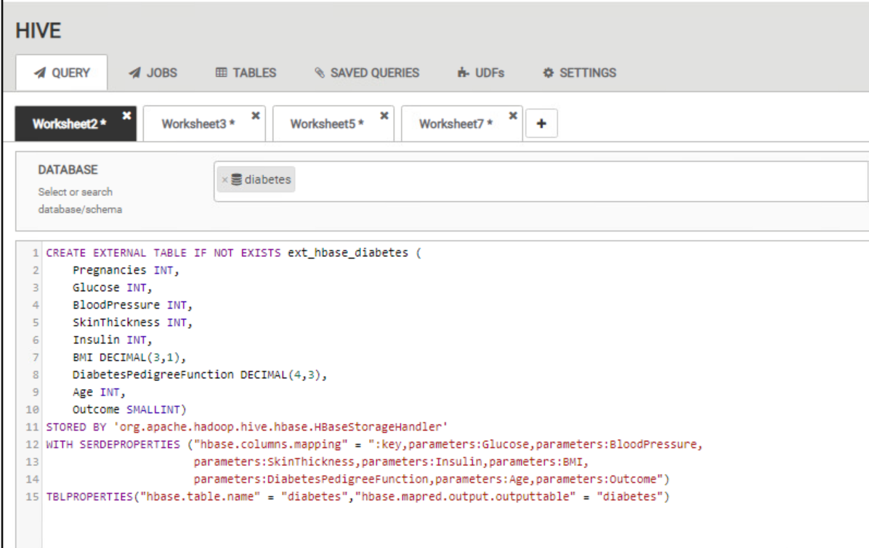
HBASE

Slide 8
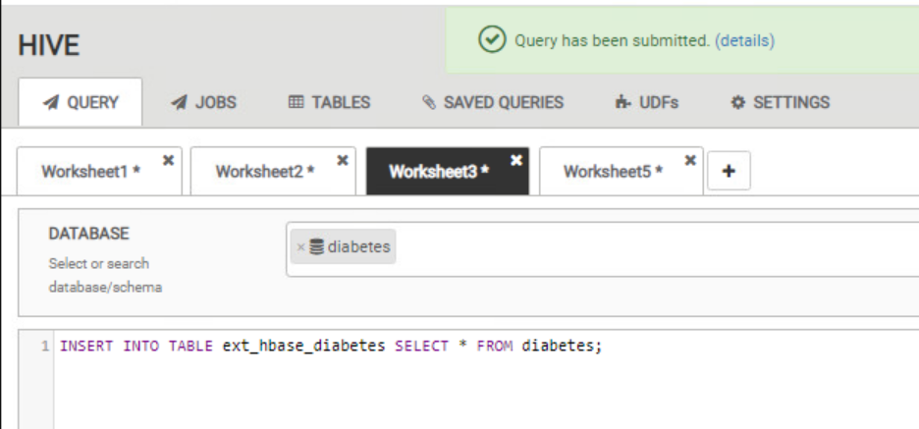
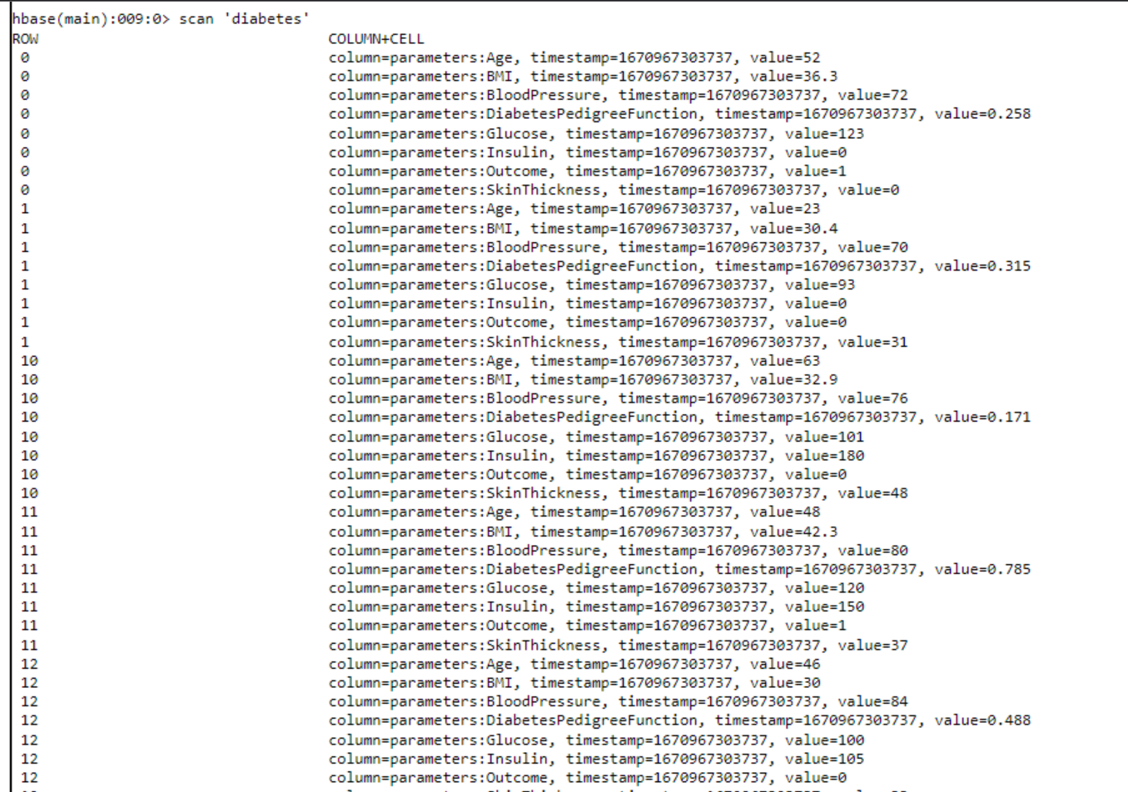
HBASE (Continued)

Slide 9
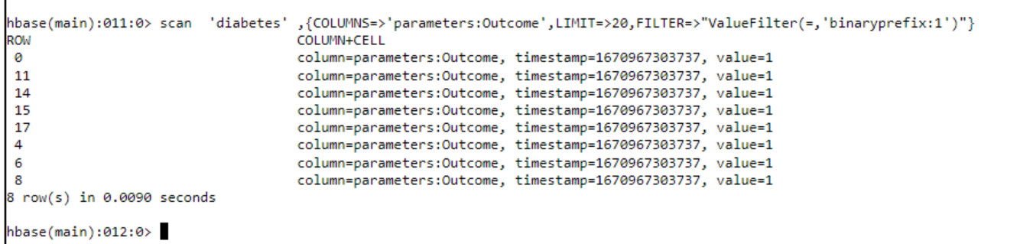
HBASE (Continued)
Filtering data where outcome is 1

Slide 10
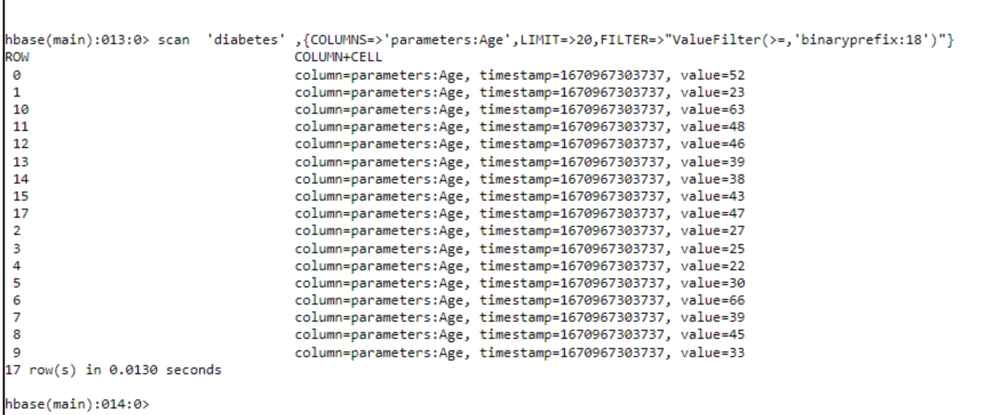
HBASE (Continued)
Filtering data with age > 18

Slide 11
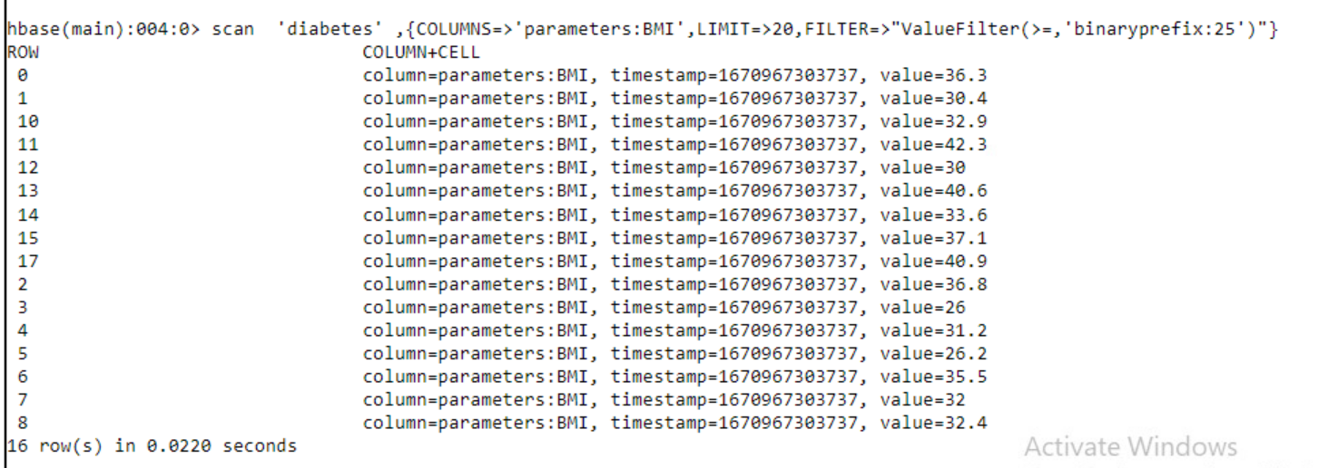
HBASE (Continued)
Filtering data for BMI > 25

Slide 12
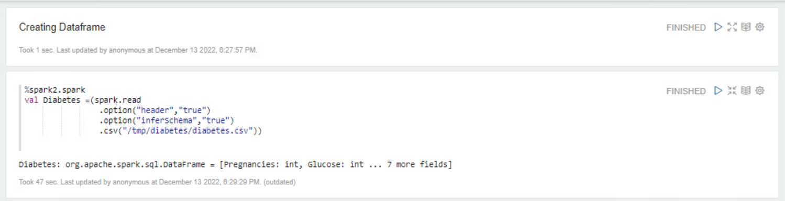
CREATING DATAFRAME

Slide 13
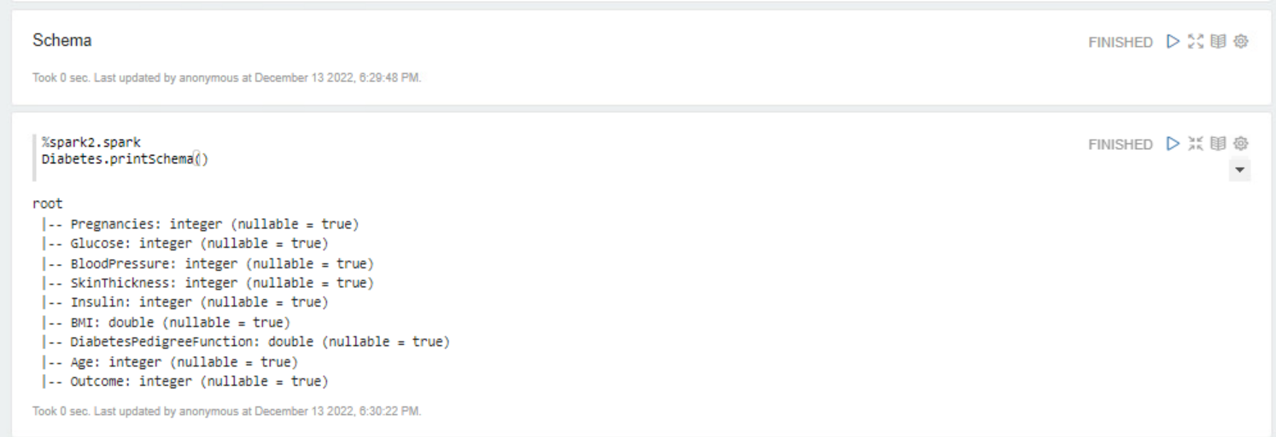
SCHEMA FOR THE DATA

Slide 14
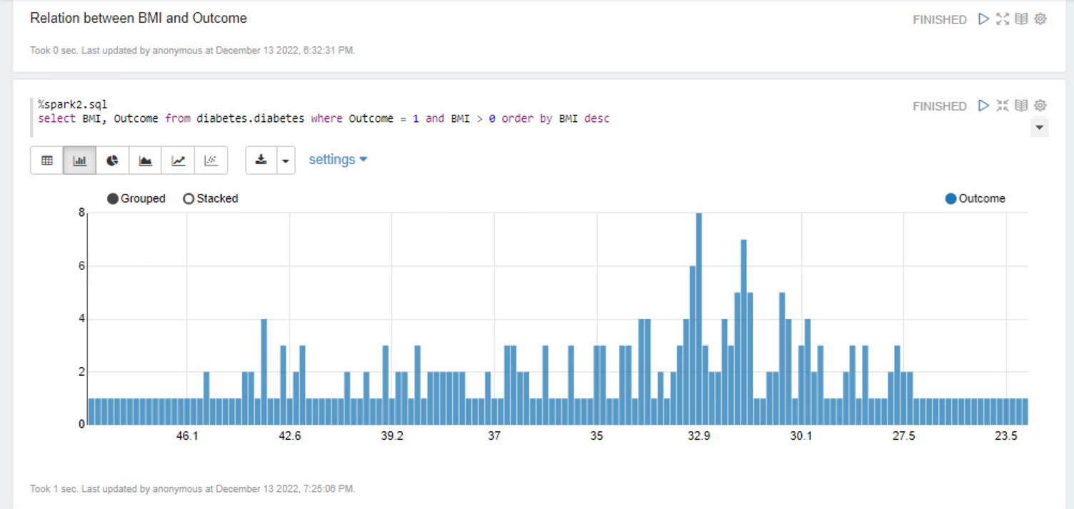
VISUALIZING THE RELATION BETWEEN BMI AND OUTCOME

Slide 15
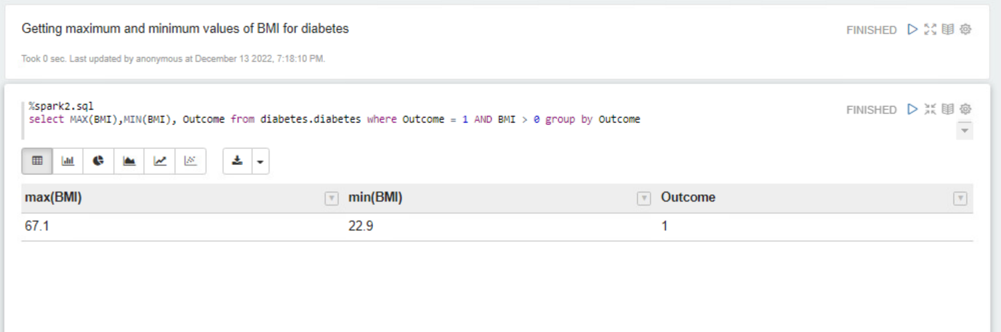
GETTING MAXIMUM AND MINIMUM VALUES OF BMI

Slide 16
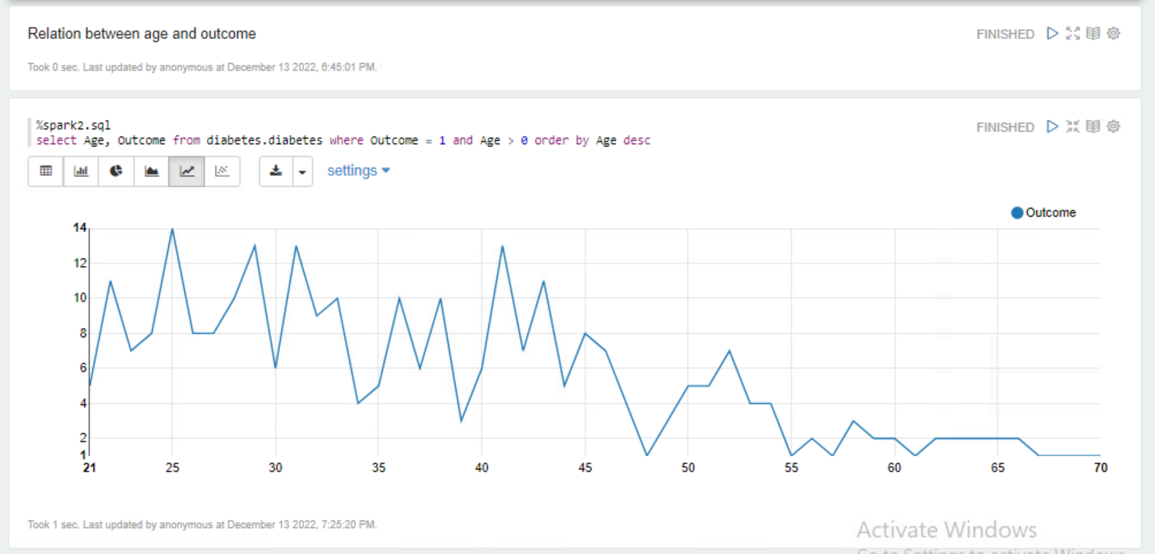
FINDING THE RELATION BETWEEN AGE AND OUTCOME

Slide 17
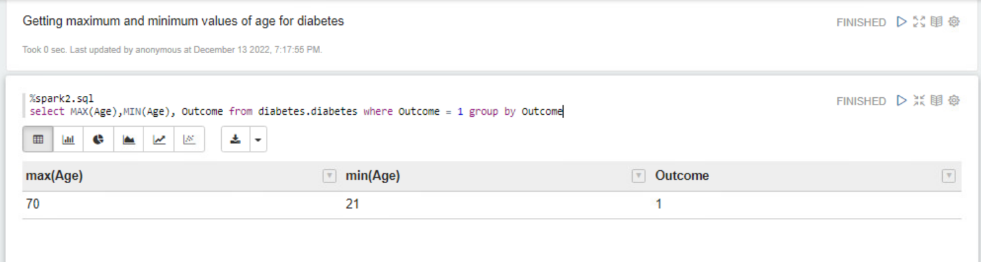
ANALYZING MAXIMUM AND MINIMUM VALUES OF AGE FOR DIABETES

Slide 18
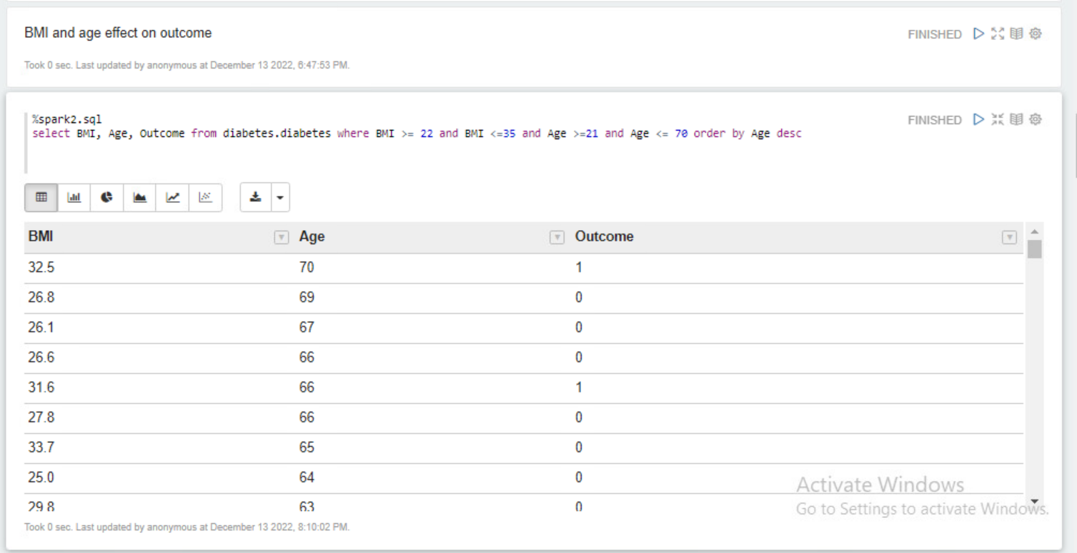
DISPLAYING BMI AND AGE EFFECT ON OUTCOME

Slide 19
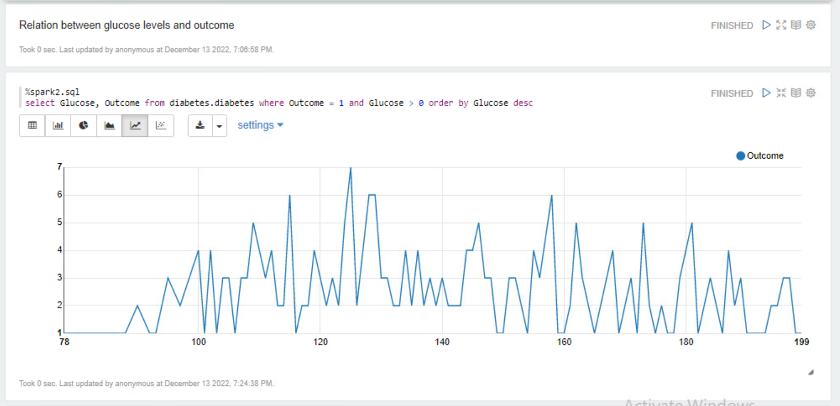
VISUALIZING THE RELATION BETWEEN GLUCOSE LEVELS & OUTCOME

Slide 20
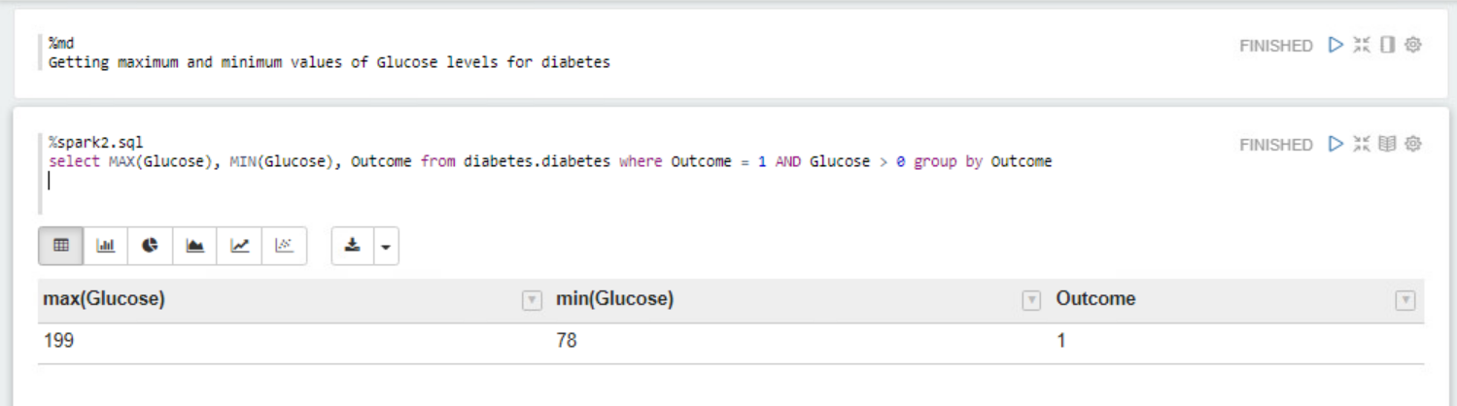
GETTING MAXIMUM & MINIMUM VALUES OF GLUCOSE LEVELS

Slide 21
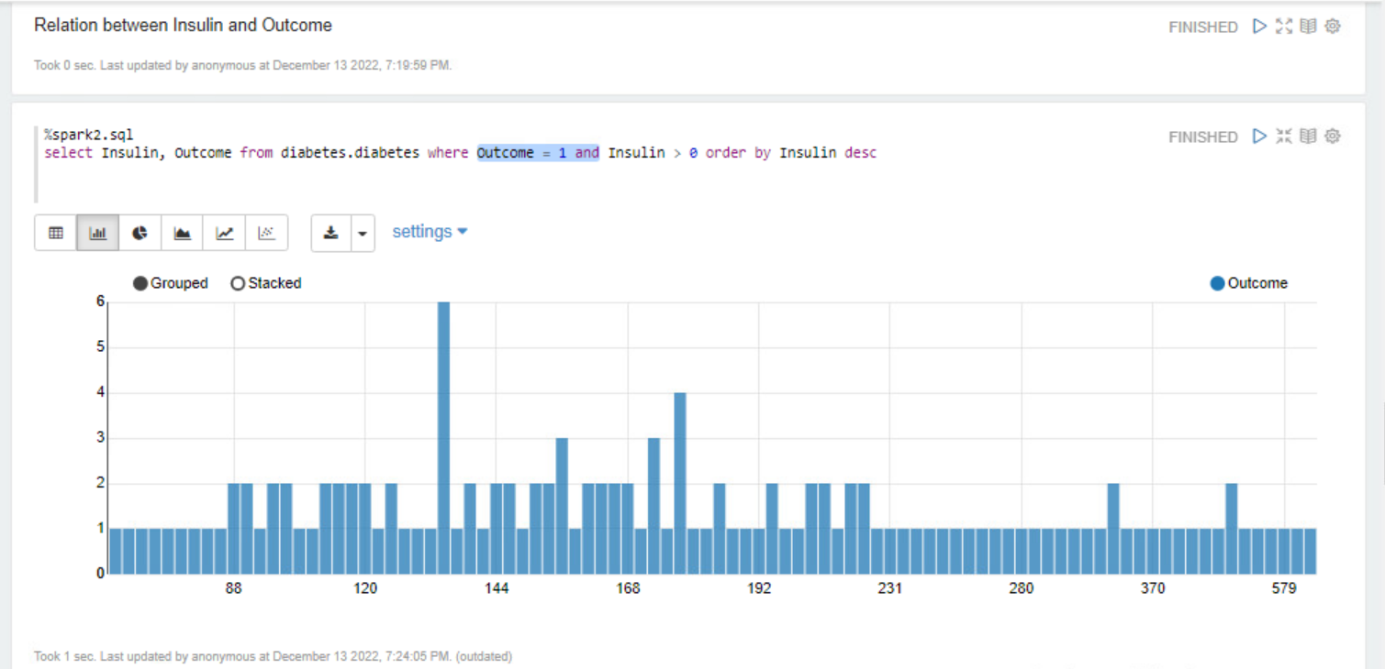
VISUALIZING RELATION BETWEEN INSULIN & OUTCOME

Slide 22
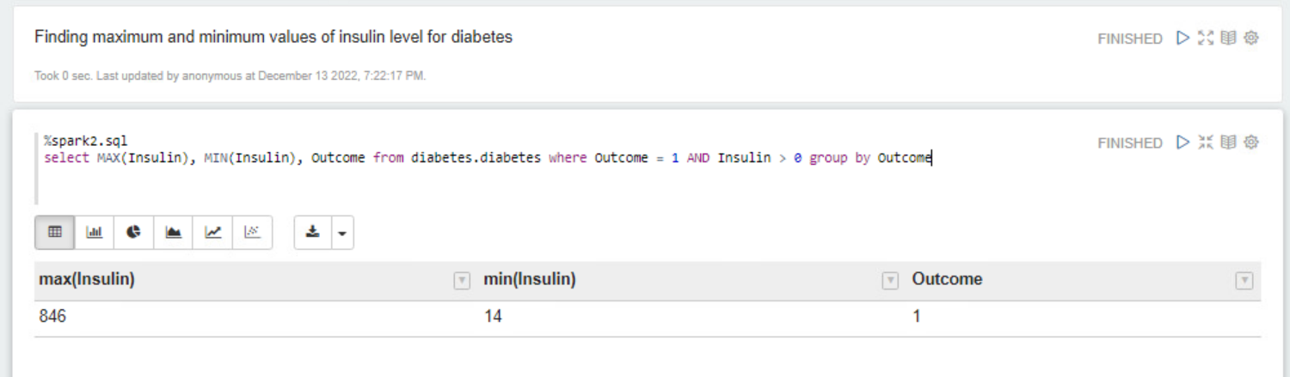
DETECTING MAXIMUM & MINIMUM VALUES OF INSULIN LEVELS

Slide 23
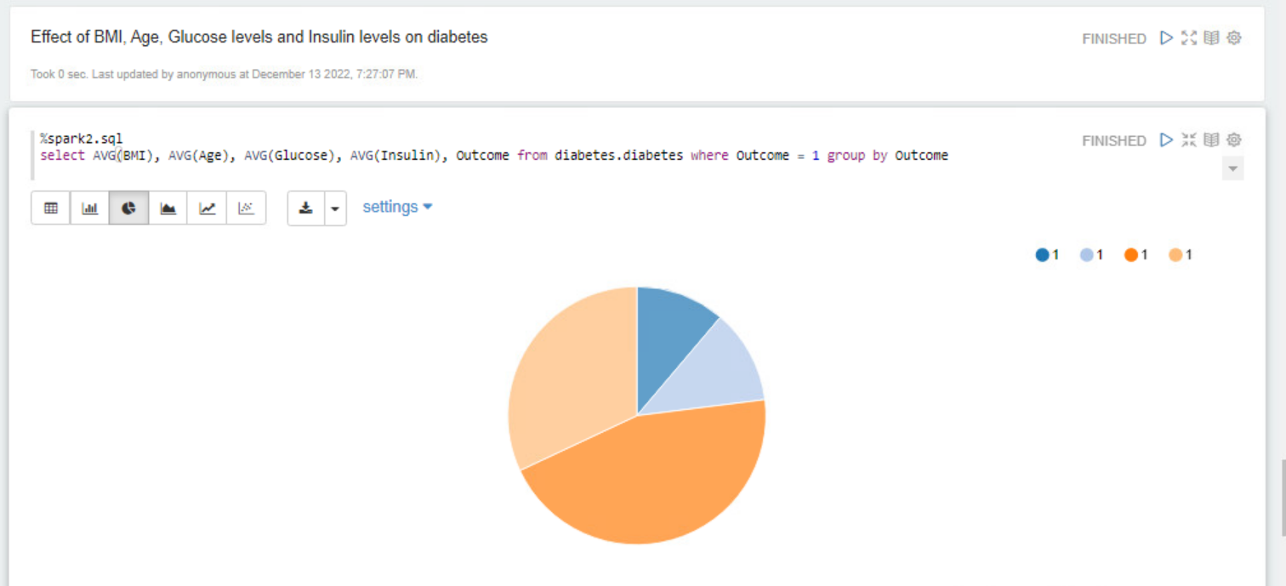
DISPLAYING EFFECT OF BMI, AGE, GLUCOSE & INSULIN LEVELS ON DIABETES

Slide 24
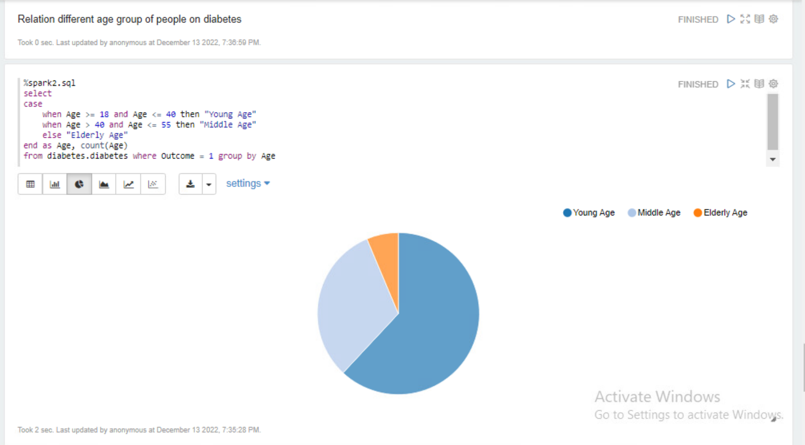
DISPLAYING RELATION OF DIFFERENT AGE GROUP OF PEOPLE ON DIABETES

Slide 25
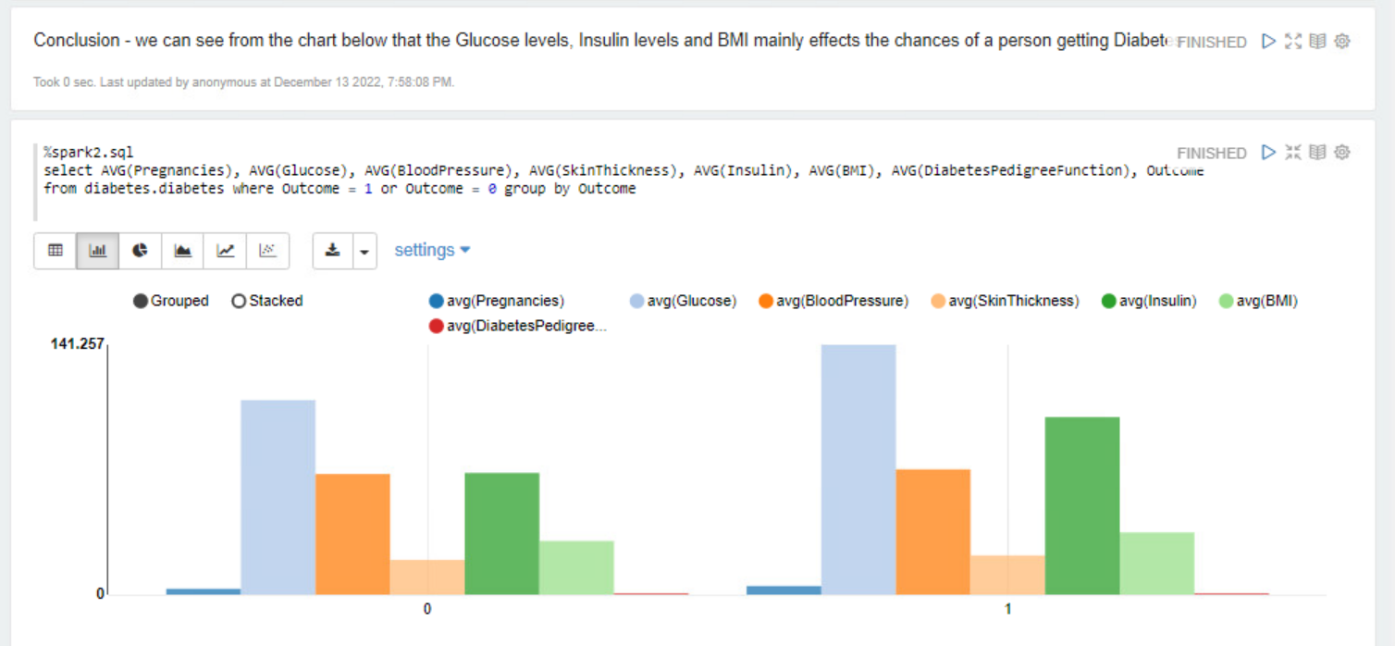
CONCLUSION

Slide 26


